Slide 1
PythonDS-13 Functions
Dr. Naveen Kumar
Associate Professor
Amity Institute of Information Technology
Amity University Patna

Slide 2
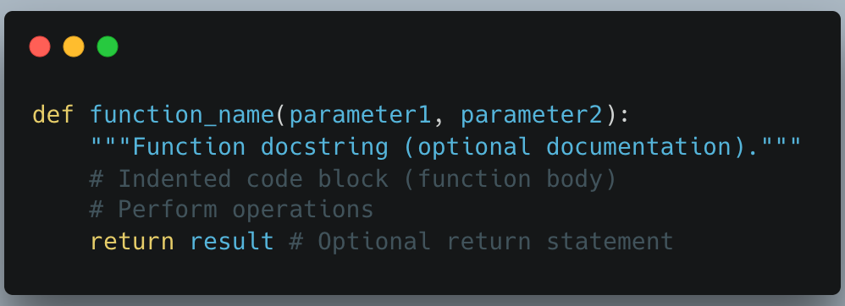
Function
A Python function is a named, reusable block of code that performs a specific task. Functions provide modularity and help avoid code repetition.
Defining a Function
Functions are defined using the def keyword in Python. The syntax is as follows:

Slide 3
Benefits of Using Functions
Code Reusability: You can call the same function multiple times in different parts of your program without rewriting the code.
Modularity: Functions help break down large programs into smaller, manageable, and logical components, making code easier to follow and debug.
Maintainability: Changes or updates to a function only need to be made in one location, benefiting the entire program.

Slide 4
Function
def The required keyword to start a function definition.
function_name A unique identifier (following variable naming rules).
() Required parentheses, which may contain parameters.
: A colon at the end of the definition line.
Indentation The code within the function must be indented. Python uses indentation to define code blocks.
return An optional statement to send a value back to the caller. If no return statement is present, the function returns None by default.
How to add docstrings to a Python function

Slide 5
Return Statement in Function
The return statement ends a function and sends a value back to the caller. It can return any data type, multiple values (packed into a tuple), or None if no value is given.
Syntax:
return [expression]
Parameters: return ends the function, [expression] is the optional value to return (defaults to None).

Slide 6
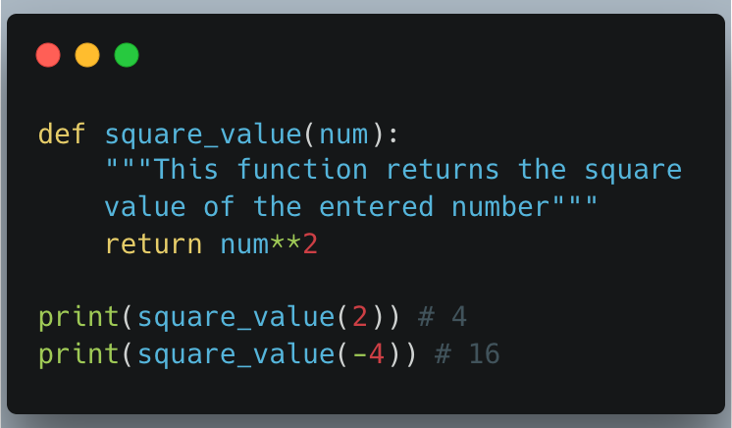

Slide 7
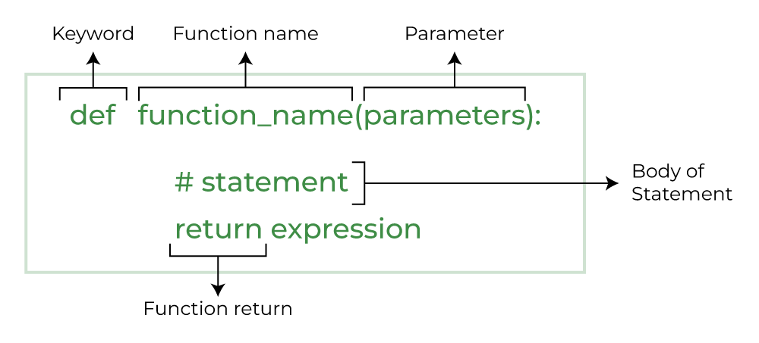

Slide 8
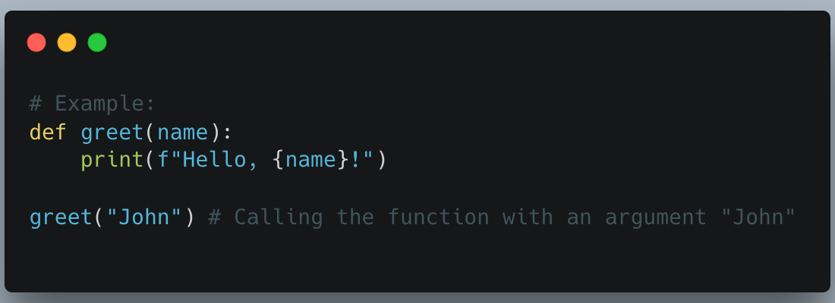
Calling a Function
To execute the code inside a function, you must "call" it using its name followed by parentheses.

Slide 9
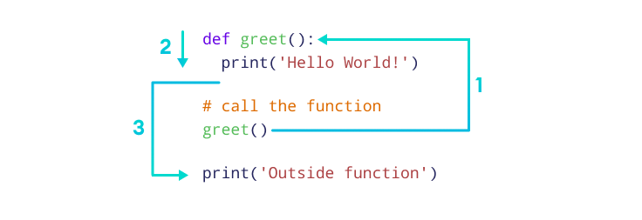

Slide 10
Function Arguments and Parameters
Parameters are the variables listed inside the parentheses in the function definition. They act as placeholders for the data the function expects to receive.
Arguments are the actual values passed to the function when it is called.
Python supports various argument types, including:
Required/Positional Arguments: Must be passed in the correct order.
Keyword Arguments: Passed by explicitly specifying the parameter name, so order doesn't matter.
Default Arguments: Parameters that assume a default value if no value is provided in the call.
Arbitrary Arguments (*args and **kwargs): Allow a function to accept a variable number of positional or keyword arguments.

Slide 11
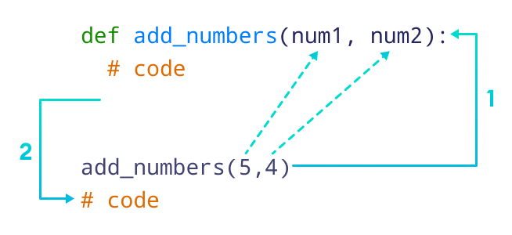

Slide 12
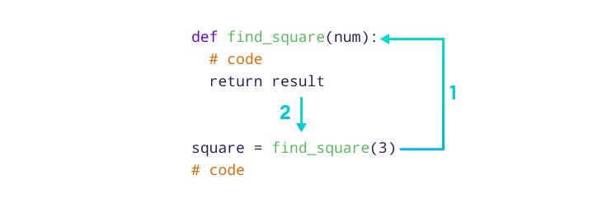

Slide 13
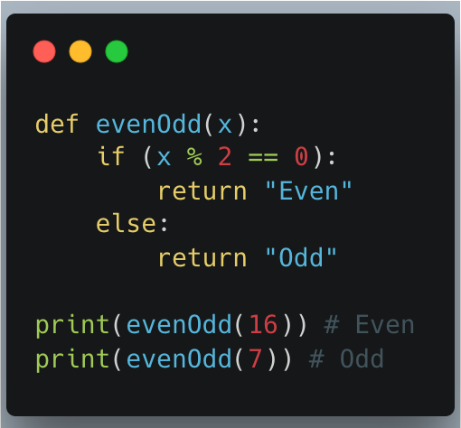
Function Argument
Types of Function Arguments
1. Default Arguments
2. Keyword Arguments
3. Positional Arguments
4. Arbitrary Arguments

Slide 14
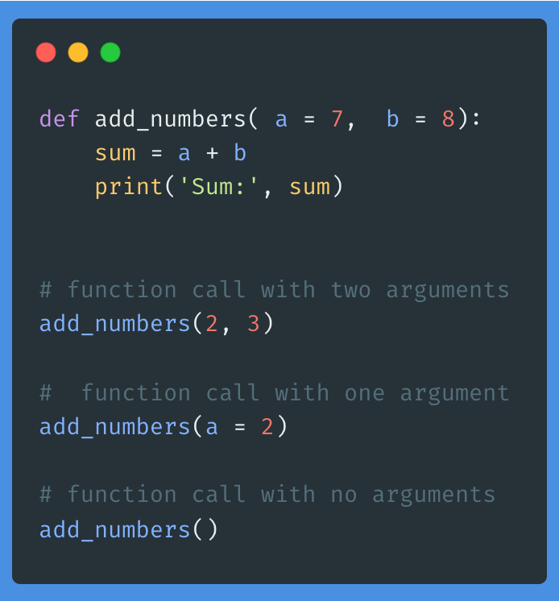
Function Argument with Default Values
In Python, we can provide default values to function arguments.
We use the = operator to provide default values. For example,

Slide 15
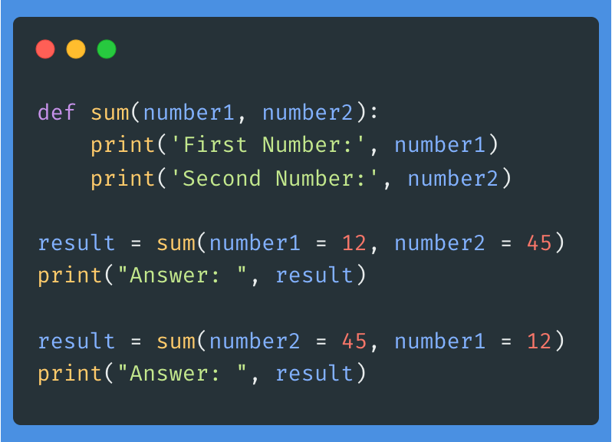
Python Keyword Argument

Slide 16
Positional Arguments
Passed to the function in the order in which they are defined.
Example
def add(a, b):
return a + b
result = add(3, 5)
print(result) # Output: 8

Slide 17
Python Function With Arbitrary Arguments
Sometimes, we do not know in advance the number of arguments that will be passed into a function.
To handle this kind of situation, we can use arbitrary arguments in Python.
Arbitrary arguments allow us to pass a varying number of values during a function call.
We use an asterisk (*) before the parameter name to denote this kind of argument. For example,

Slide 18
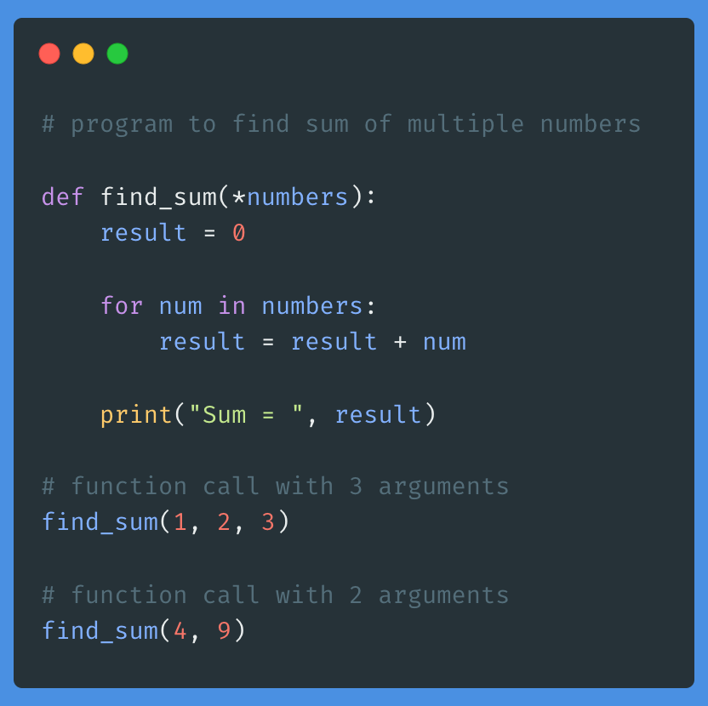

Slide 19
Function within Functions (Neste Function)
Basic Nested Function
A function is defined inside another function.
Example
def outer_function():
def inner_function():
print("Hello from the inner function!")
print("Hello from the outer function!")
inner_function()
outer_function()
# Output:
# Hello from the outer function!
# Hello from the inner function!

Slide 20
Accessing Variables from the Enclosing Function (Nested function)
Nested functions can access and modify variables from the enclosing function.
Example
def outer_function(message):
def inner_function():
print(f"Message from outer function: {message}")
inner_function()
outer_function("Hello, World!")
# Output: Message from outer function: Hello, World!

Slide 21
Creating Closures (Nested Function)
A closure is a function object that remembers values in the enclosing scopes even if they are not present in memory.
Example
def make_multiplier(x):
def multiplier(n):
return x * n
return multiplier
times_two = make_multiplier(2)
times_three = make_multiplier(3)
print(times_two(5)) # Output: 10
print(times_three(5)) # Output: 15

Slide 22
Using Nested Functions for Encapsulation
Encapsulate functionality to keep parts of your code clean and organized.
Example
def calculate_area_and_perimeter(length, width):
def area():
return length * width
def perimeter():
return 2 * (length + width)
return area(), perimeter()
area, perimeter = calculate_area_and_perimeter(5, 3)
print(f"Area: {area}, Perimeter: {perimeter}")
# Output: Area: 15, Perimeter: 16

Slide 23
Anonymous Functions

Slide 24
Higher-Order Functions
These functions can take other functions as arguments or return them as results. Examples include map(), filter(), and reduce().
Example
def square(x):
return x * x
numbers = [1, 2, 3, 4, 5]
squared_numbers = list(map(square, numbers))
print(squared_numbers) # Output: [1, 4, 9, 16, 25]

Slide 25
Generator Functions
These functions yield values one at a time and can produce a sequence of values over time, using the yield keyword.
Example
def generate_numbers():
for i in range(1, 6):
yield i
for number in generate_numbers():
print(number) # Output: 1 2 3 4 5

Slide 26
Pass by Reference and Pass by Value
In Python, variables are references to objects. When we pass them to a function, the behavior depends on whether the object is mutable (like lists, dictionaries) or immutable (like integers, strings, tuples).
Mutable objects: Changes inside the function affect the original object.
Immutable objects: The original value remains unchanged.

Slide 27
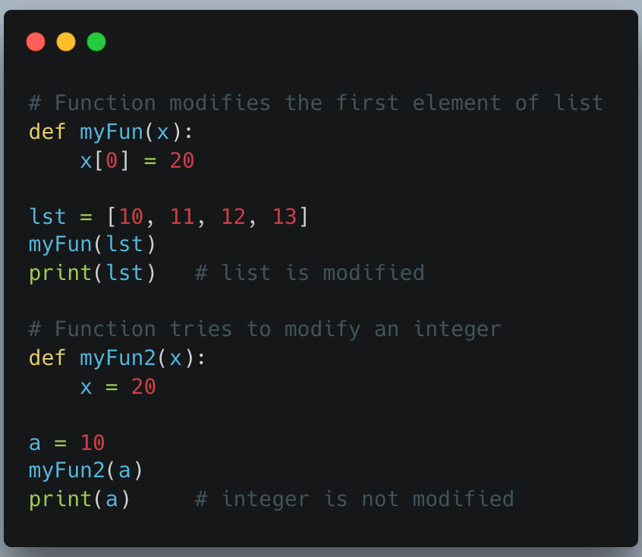

Slide 28
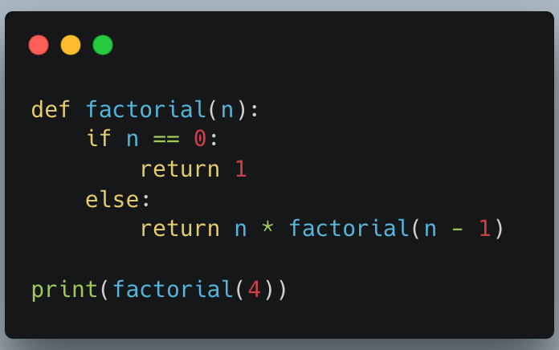
Recursive Functions
A recursive function is a function that calls itself to solve a problem. It is commonly used in mathematical and divide-and-conquer problems. Always include a base case to avoid infinite recursion.

Slide 29
Returning a Value
The return statement can be used to ‘return’ a value from a function.
Example
def add(a, b):
return a + b
result = add(3, 5)
print(result) # Output: 8

Slide 30
Returning Multiple Values
Python functions can return multiple values by using tuples.
Example
def get_name_and_age():
name = "Alice"
age = 30
return name, age
name, age = get_name_and_age()
print(f"Name: {name}, Age: {age}") # Output: Name: Alice, Age: 30

Slide 31
Returning a List
A function can return complex data structures like lists.
Example
def get_even_numbers(limit):
evens = []
for num in range(limit):
if num % 2 == 0:
evens.append(num)
return evens
even_numbers = get_even_numbers(10)
print(even_numbers) # Output: [0, 2, 4, 6, 8]

Slide 32
Returning Early
The return statement can be used to exit a function early.
Example
def check_positive(number):
if number <= 0:
return "Not a positive number"
return "Positive number"
result = check_positive(-5)
print(result) # Output: Not a positive number
result = check_positive(10)
print(result) # Output: Positive number

Slide 33
The pass Statement
1. Placeholder for Future Code
The ‘pass’ statement is used as a placeholder for code that will be added later.
Example
def future_function():
pass
# This function does nothing but can be implemented later

Slide 34
2. Used in Loops
The ‘pass’ statement can be used in loops where the loop's body is intentionally left empty.
Example
for i in range(10):
pass # Placeholder for future code
# This loop does nothing currently

Slide 35
3. Used in Conditional Statements
The ‘pass’ statement can be used in ‘if’ statements where no action is required for a particular condition.
Example
x = 10
if x > 0:
pass # Positive number, no action needed
else:
print("Negative number")
# Currently, nothing happens if x > 0

Slide 36
4. Used in Class Definitions
The pass statement can be used in class definitions as a placeholder for future methods and attributes.
Example
class MyClass:
pass
# This class currently does nothing but can be expanded later

Slide 37
Sno. | Function Name | Description
1 | Python abs() Function | Return the absolute value of a number
2 | Python aiter() Function | It takes an asynchronous iterable as an argument and returns an asynchronous iterator for that iterable
3 | Python all() Function | Return true if all the elements of a given iterable( List, Dictionary, Tuple, set, etc) are True else it returns False
4 | Python any() Function | Returns true if any of the elements of a given iterable( List, Dictionary, Tuple, set, etc) are True else it returns False
5 | Python anext() Function | used for getting the next item from an asynchronous iterator
6 | Python ascii() Function | Returns a string containing a printable representation of an object
7 | Python bin() Function | Convert integer to a binary string
8 | Python bool() Function | Return or convert a value to a Boolean value i.e., True or False
9 | Python breakpoint() Function | It is used for dropping into the debugger at the call site during runtime for debugging purposes
10 | Python bytearray() Function | Returns a byte array object which is an array of given bytes
11 | Python bytes() Function | Converts an object to an immutable byte-represented object of a given size and data
12 | Python callable() Function | Returns True if the object passed appears to be callable
13 | Python chr() Function | Returns a string representing a character whose Unicode code point is an integer
14 | Python classmethod() Function | Returns a class method for a given function
15 | Python compile() Function | Returns a Python code object
16 | Python complex() Function | Creates Complex Number

Slide 38
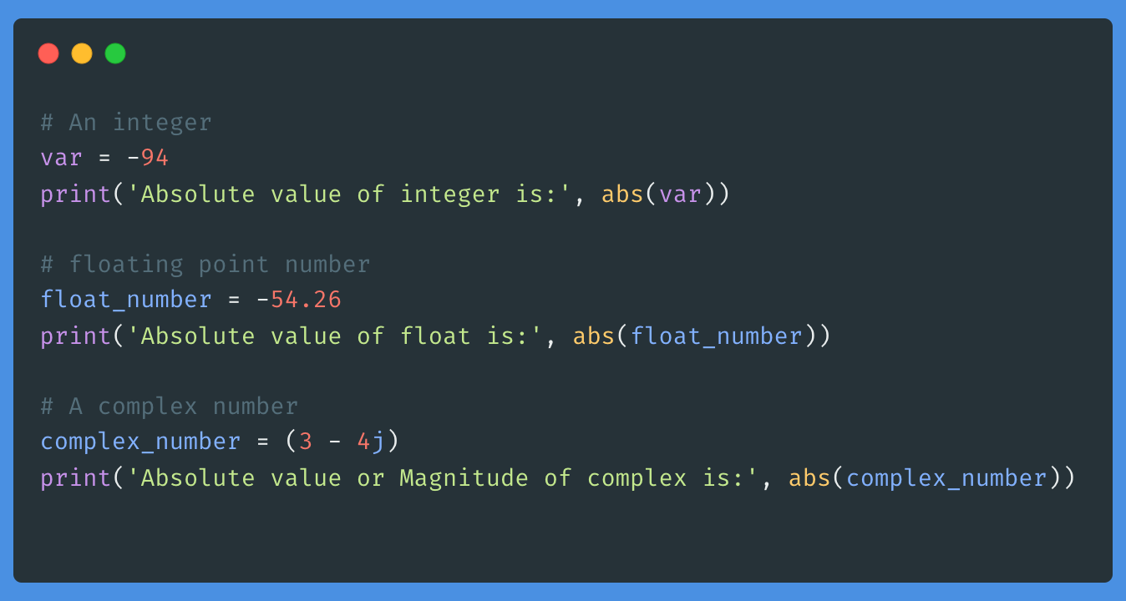
abs()

Slide 39
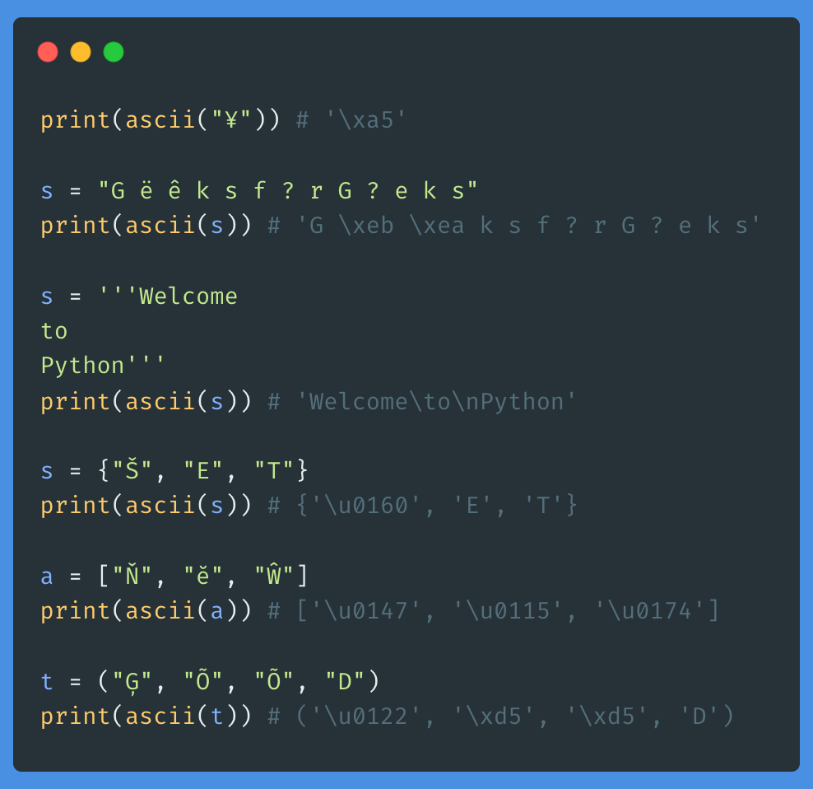

Slide 40
False Values and Truth Values:
False Values:
False: The Boolean value False.
None: The None keyword, which represents the absence of a value.
0: The integer zero.
0.0: The floating-point zero.
"": An empty string.
[]: An empty list.
(): An empty tuple.
{}: An empty dictionary.
set(): An empty set.
range(0): An empty range.
Truth Values:
Non-zero numbers (e.g., 1, -1, 3.14).
Non-empty strings (e.g., "hello").
Non-empty collections (e.g., [1, 2, 3], {"key": "value"}).
Objects (e.g., instances of classes).

Slide 41
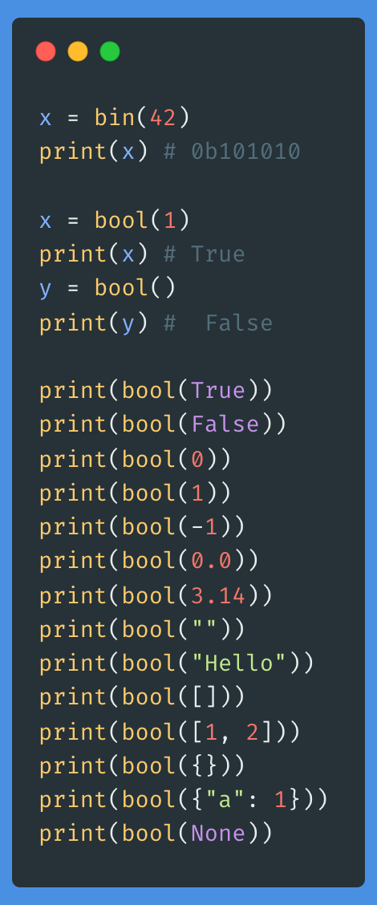
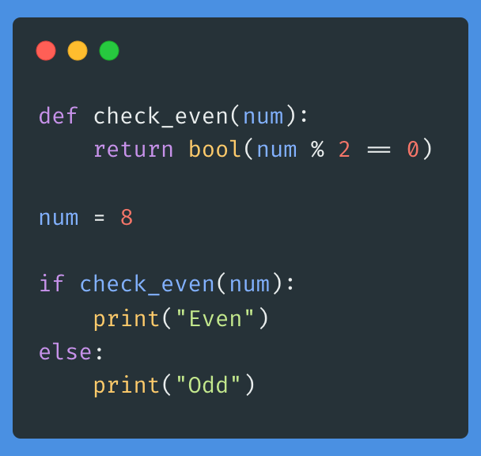

Slide 42
bytes()
bytes() method in Python is used to create a sequence of bytes. In this article, we will check How bytes() methods works in Python.

Slide 43
Built-in function: len() Function
Returns the length (number of items) of an object.
Example
my_list = [1, 2, 3, 4, 5]
print(len(my_list)) # Output: 5
my_string = "Hello, World!"
print(len(my_string)) # Output: 13

Slide 44
Built-in: max() and min() Functions
max() returns the largest item in an iterable or the largest of two or more arguments.
min() returns the smallest item in an iterable or the smallest of two or more arguments.
Example
numbers = [10, 20, 30, 40, 50]
print(max(numbers)) # Output: 50
print(min(numbers)) # Output: 10

Slide 45
Built-in: ‘sum()’ Function
Sums the items of an iterable, such as a list or tuple.
Example
numbers = [1, 2, 3, 4, 5]
print(sum(numbers)) # Output: 15

Slide 46
Built-in: ‘sorted()’ Function
Returns a new sorted list from the elements of any iterable.
Example
numbers = [3, 1, 4, 1, 5, 9]
sorted_numbers = sorted(numbers)
print(sorted_numbers) # Output: [1, 1, 3, 4, 5, 9]

Slide 47
Built-in: ‘abs()’ Function
Returns the absolute value of a number.
Example
number = -10
print(abs(number)) # Output: 10

Slide 48
Built-in: ‘round()’ Function
Rounds a number to a specified number of decimal places.
Example
number = 3.14159
print(round(number, 2)) # Output: 3.14

Slide 49
Built-in: ‘enumerate()’ Function
Adds a counter to an iterable and returns it as an enumerate object.
Example
items = ['apple', 'banana', 'cherry']
for index, item in enumerate(items):
print(index, item)
# Output:
# 0 apple
# 1 banana
# 2 cherry

Slide 50
Built-in: ‘zip()’ Function
Aggregates elements from two or more iterables (lists, tuples, etc.) and returns an iterator of tuples.
Example
names = ['Alice', 'Bob', 'Charlie']
scores = [85, 90, 95]
combined = zip(names, scores)
for name, score in combined:
print(name, score)
# Output:
# Alice 85
# Bob 90
# Charlie 95

Slide 51
Built-in: map()’ Function
Applies a function to all items in an input list (or other iterable) and returns a map object (an iterator).
Example
def square(x):
return x * x
numbers = [1, 2, 3, 4, 5]
squared_numbers = map(square, numbers)
print(list(squared_numbers)) # Output: [1, 4, 9, 16, 25]

Slide 52
Built-in: ‘filter()’ Function
Filters items out of an iterable based on a function that returns True or False.
Example
def is_even(x):
return x % 2 == 0
numbers = [1, 2, 3, 4, 5, 6]
even_numbers = filter(is_even, numbers)
print(list(even_numbers)) # Output: [2, 4, 6]

Slide 53
Sn. | Function Name | Description
12 | Python callable() Function | Returns True if the object passed appears to be callable
13 | Python chr() Function | Returns a string representing a character whose Unicode code point is an integer
14 | Python classmethod() Function | Returns a class method for a given function
15 | Python compile() Function | Returns a Python code object
16 | Python complex() Function | Creates Complex Number
17 | Python delattr() Function | Delete the named attribute from the object
18 | Python dict() Function | Creates a Python Dictionary
19 | Python dir() Function | Returns a list of the attributes and methods of any object
20 | Python divmod() Function | Takes two numbers and returns a pair of numbers consisting of their quotient and remainder
21 | Python enumerate() Function | Adds a counter to an iterable and returns it in a form of enumerating object
22 | Python eval() Function | Parses the expression passed to it and runs Python expression(code) within the program
23 | Python exec() Function | Used for the dynamic execution of the program
24 | Python filter() Function | Filters the given sequence with the help of a function that tests each element in the sequence to be true or not
25 | Python float() Function | Return a floating-point number from a number or a string
26 | Python format() Function | Formats a specified value
 | Python frozenset() Function | Returns immutable frozenset
 | Python getattr() Function | Access the attribute value of an object
 | Python globals() Function | Returns the dictionary of the current global symbol table
 | Python hasattr() Function | Check if an object has the given named attribute and return true if present
 | Python hash() Function | Encode the data into an unrecognizable value
 | Python help() Function | Display the documentation of modules, functions, classes, keywords, etc
 | Python hex() Function | Convert an integer number into its corresponding hexadecimal form
 | Python id() Function | Return the identity of an object
 | Python input() Function | Take input from the user as a string
 | Python int() Function | Converts a number in a given base to decimal
 | Python isinstance() Function | Checks if the objects belong to a certain class or not
 | Python issubclass() Function | Check if a class is a subclass of another class or not
 | Python iter() Function | Convert an iterable to an iterator
 | Python len() Function | Returns the length of the object
 | Python list() Function | Creates a list in Python
 | Python locals() Function | Returns the dictionary of the current local symbol table
 | Python map() Function | Returns a map object(which is an iterator) of the results after applying the given function to each item of a given iterable
 | Python max() Function | Returns the largest item in an iterable or the largest of two or more arguments
 | Python memoryview() Function | Returns memory view of an argument
 | Python min() Function | Returns the smallest item in an iterable or the smallest of two or more arguments
 | Python next() Function | Receives the next item from the iterator
 | Python object() Function | Returns a new object
 | Python oct() Function | returns an octal representation of an integer in a string format.
 | Python open() Function | Open a file and return its object
 | Python ord() Function | Returns the Unicode equivalence of the passed argument
 | Python pow() Function | Compute the power of a number
 | Python print() Function | Print output to the console
 | Python property() Function | Create a property of a class
 | Python range() Function | Generate a sequence of numbers
 | Python repr() Function | Return the printable version of the object
 | Python reversed() Function | Returns an iterator that accesses the given sequence in the reverse order
 | Python round() Function | Rounds off to the given number of digits and returns the floating-point number
 | Python set() Function | Convert any of the iterable to a sequence of iterable elements with distinct elements
 | Python setattr() Function | Assign the object attribute its value
 | Python slice() Function | Returns a slice object
 | Python sorted() Function | Returns a list with the elements in a sorted manner, without modifying the original sequence
 | Python staticmethod() Function | Converts a message into the static message
 | Python str() Function | Returns the string version of the object
 | Python sum() Function | Sums up the numbers in the list
 | Python super() Function | Returns a temporary object of the superclass
 | Python tuple() Function | Creates a tuple in Python
 | Python type() Function | Returns the type of the object
 | Python vars() Function | Returns the __dict__ attribute for a module, class, instance, or any other object
 | Python zip() Function | Maps the similar index of multiple containers
 | Python __import__() Function | Imports the module during runtime

Slide 54
Sn. | Function Name | Description
26 | Python format() Function | Formats a specified value
27 | Python frozenset() Function | Returns immutable frozenset
28 | Python getattr() Function | Access the attribute value of an object
29 | Python globals() Function | Returns the dictionary of the current global symbol table
30 | Python hasattr() Function | Check if an object has the given named attribute and return true if present
31 | Python hash() Function | Encode the data into an unrecognizable value
32 | Python help() Function | Display the documentation of modules, functions, classes, keywords, etc
33 | Python hex() Function | Convert an integer number into its corresponding hexadecimal form
34 | Python id() Function | Return the identity of an object
35 | Python input() Function | Take input from the user as a string
36 | Python int() Function | Converts a number in a given base to decimal
37 | Python isinstance() Function | Checks if the objects belong to a certain class or not
38 | Python issubclass() Function | Check if a class is a subclass of another class or not
39 | Python iter() Function | Convert an iterable to an iterator
40 | Python len() Function | Returns the length of the object
42 | Python list() Function | Creates a list in Python
42 | Python locals() Function | Returns the dictionary of the current local symbol table
 | Python map() Function | Returns a map object(which is an iterator) of the results after applying the given function to each item of a given iterable
 | Python max() Function | Returns the largest item in an iterable or the largest of two or more arguments
 | Python memoryview() Function | Returns memory view of an argument
 | Python min() Function | Returns the smallest item in an iterable or the smallest of two or more arguments
 | Python next() Function | Receives the next item from the iterator
 | Python object() Function | Returns a new object
 | Python oct() Function | returns an octal representation of an integer in a string format.
 | Python open() Function | Open a file and return its object
 | Python ord() Function | Returns the Unicode equivalence of the passed argument
 | Python pow() Function | Compute the power of a number
 | Python print() Function | Print output to the console
 | Python property() Function | Create a property of a class
 | Python range() Function | Generate a sequence of numbers
 | Python repr() Function | Return the printable version of the object
 | Python reversed() Function | Returns an iterator that accesses the given sequence in the reverse order
 | Python round() Function | Rounds off to the given number of digits and returns the floating-point number
 | Python set() Function | Convert any of the iterable to a sequence of iterable elements with distinct elements
 | Python setattr() Function | Assign the object attribute its value
 | Python slice() Function | Returns a slice object
 | Python sorted() Function | Returns a list with the elements in a sorted manner, without modifying the original sequence
 | Python staticmethod() Function | Converts a message into the static message
 | Python str() Function | Returns the string version of the object
 | Python sum() Function | Sums up the numbers in the list
 | Python super() Function | Returns a temporary object of the superclass
 | Python tuple() Function | Creates a tuple in Python
 | Python type() Function | Returns the type of the object
 | Python vars() Function | Returns the __dict__ attribute for a module, class, instance, or any other object
 | Python zip() Function | Maps the similar index of multiple containers
 | Python __import__() Function | Imports the module during runtime

Slide 55
Sn. | Function Name | Description
43 | Python map() Function | Returns a map object(which is an iterator) of the results after applying the given function to each item of a given iterable
44 | Python max() Function | Returns the largest item in an iterable or the largest of two or more arguments
45 | Python memoryview() Function | Returns memory view of an argument
46 | Python min() Function | Returns the smallest item in an iterable or the smallest of two or more arguments
47 | Python next() Function | Receives the next item from the iterator
48 | Python object() Function | Returns a new object
49 | Python oct() Function | returns an octal representation of an integer in a string format.
50 | Python open() Function | Open a file and return its object
51 | Python ord() Function | Returns the Unicode equivalence of the passed argument
52 | Python pow() Function | Compute the power of a number
53 | Python print() Function | Print output to the console
54 | Python property() Function | Create a property of a class
55 | Python range() Function | Generate a sequence of numbers
56 | Python repr() Function | Return the printable version of the object
57 | Python reversed() Function | Returns an iterator that accesses the given sequence in the reverse order
58 | Python round() Function | Rounds off to the given number of digits and returns the floating-point number
 | Python set() Function | Convert any of the iterable to a sequence of iterable elements with distinct elements
 | Python setattr() Function | Assign the object attribute its value
 | Python slice() Function | Returns a slice object
 | Python sorted() Function | Returns a list with the elements in a sorted manner, without modifying the original sequence
 | Python staticmethod() Function | Converts a message into the static message
 | Python str() Function | Returns the string version of the object
 | Python sum() Function | Sums up the numbers in the list
 | Python super() Function | Returns a temporary object of the superclass
 | Python tuple() Function | Creates a tuple in Python
 | Python type() Function | Returns the type of the object
 | Python vars() Function | Returns the __dict__ attribute for a module, class, instance, or any other object
 | Python zip() Function | Maps the similar index of multiple containers
 | Python __import__() Function | Imports the module during runtime

Slide 56
Sn. | Function Name | Description
58 | Python round() Function | Rounds off to the given number of digits and returns the floating-point number
59 | Python set() Function | Convert any of the iterable to a sequence of iterable elements with distinct elements
60 | Python setattr() Function | Assign the object attribute its value
61 | Python slice() Function | Returns a slice object
62 | Python sorted() Function | Returns a list with the elements in a sorted manner, without modifying the original sequence
63 | Python staticmethod() Function | Converts a message into the static message
64 | Python str() Function | Returns the string version of the object
65 | Python sum() Function | Sums up the numbers in the list
66 | Python super() Function | Returns a temporary object of the superclass
67 | Python tuple() Function | Creates a tuple in Python
68 | Python type() Function | Returns the type of the object
69 | Python vars() Function | Returns the __dict__ attribute for a module, class, instance, or any other object
70 | Python zip() Function | Maps the similar index of multiple containers
71 | Python __import__() Function | Imports the module during runtime

Slide 57
Reverse a number using Recursing methods
def revN(n, nn):
if n==0:
return nn
r = n%10
nn = nn * 10 + r
return revN(n//10, nn)
print("Reverse: ", revN(12345, 0))

